Slide 1

Day One Home Work Display
Jiaqi Li

Slide 2
Brief Introduction
Polar coordinates explanation
4 params animals display
Scrape of China Daily
filtering

Slide 3
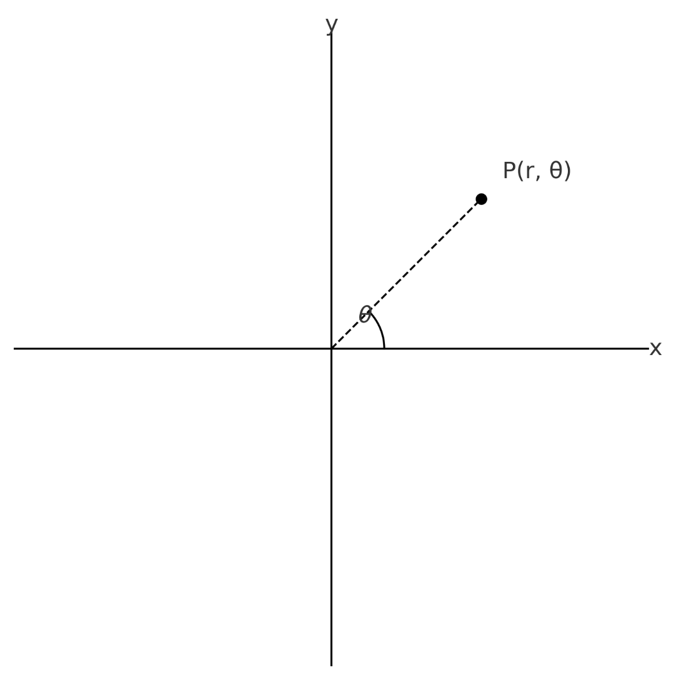
Polar coordinates
Describe a point by (r, θ) instead of (x, y)
r = distance from origin (radius)
θ = angle from positive x-axis
Conversion formulas:
x=r cosθ
y=r sinθ
r=(x^2+y^2)^1/2
θ =​arctan(y/x)
Polar coordinates are better for circles, ellipses

Slide 4
4 Params Animals Display:Abstract version

Slide 5
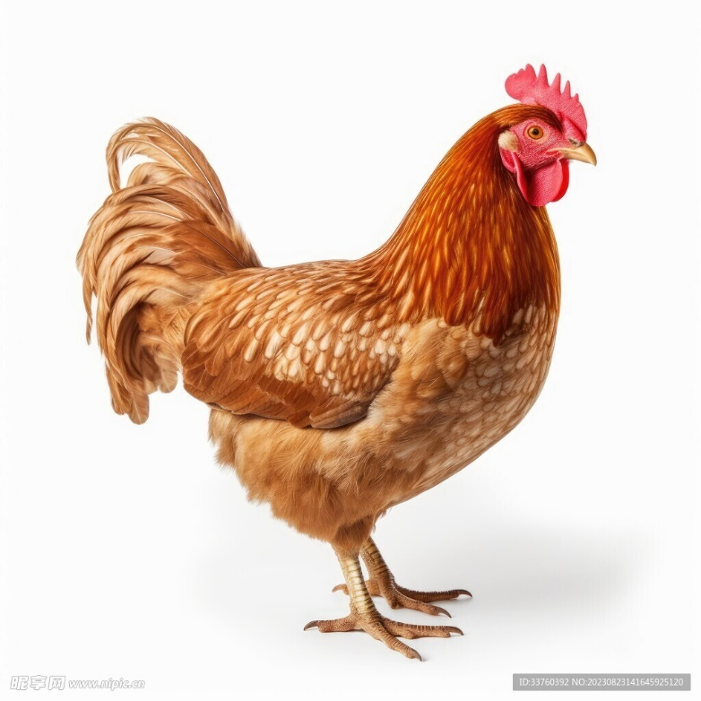
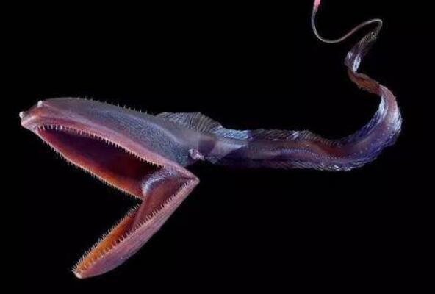
4 Params Animals Display:Comparative version
Chicken
65-50j, -35+20j, 30-10j, 25-65j, 48+25j
Eurypharynx pelecanoides
50-60j, 35-20j, -20-5j, -10-30j, 22+15j

Slide 6
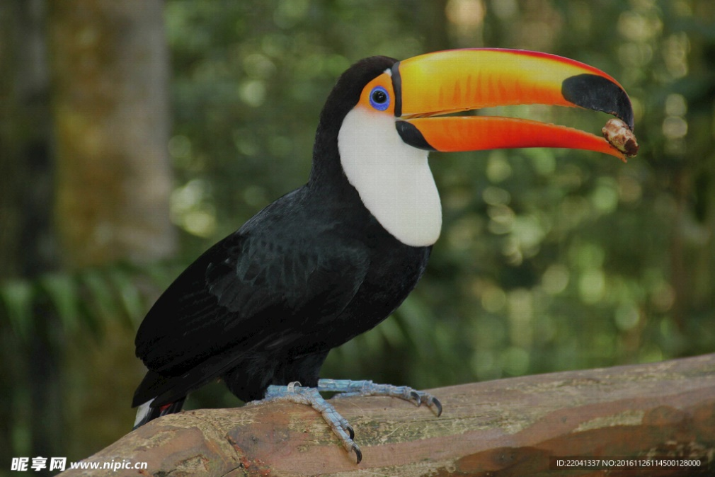

4 Params Animals Display:Comparative version
toucan
[65-70j, 35+42j, -22+8j, -18-52j, 42+28j
Hummingbird
60-80j, -25+30j, 10-15j, 20-60j, 35+20j

Slide 7
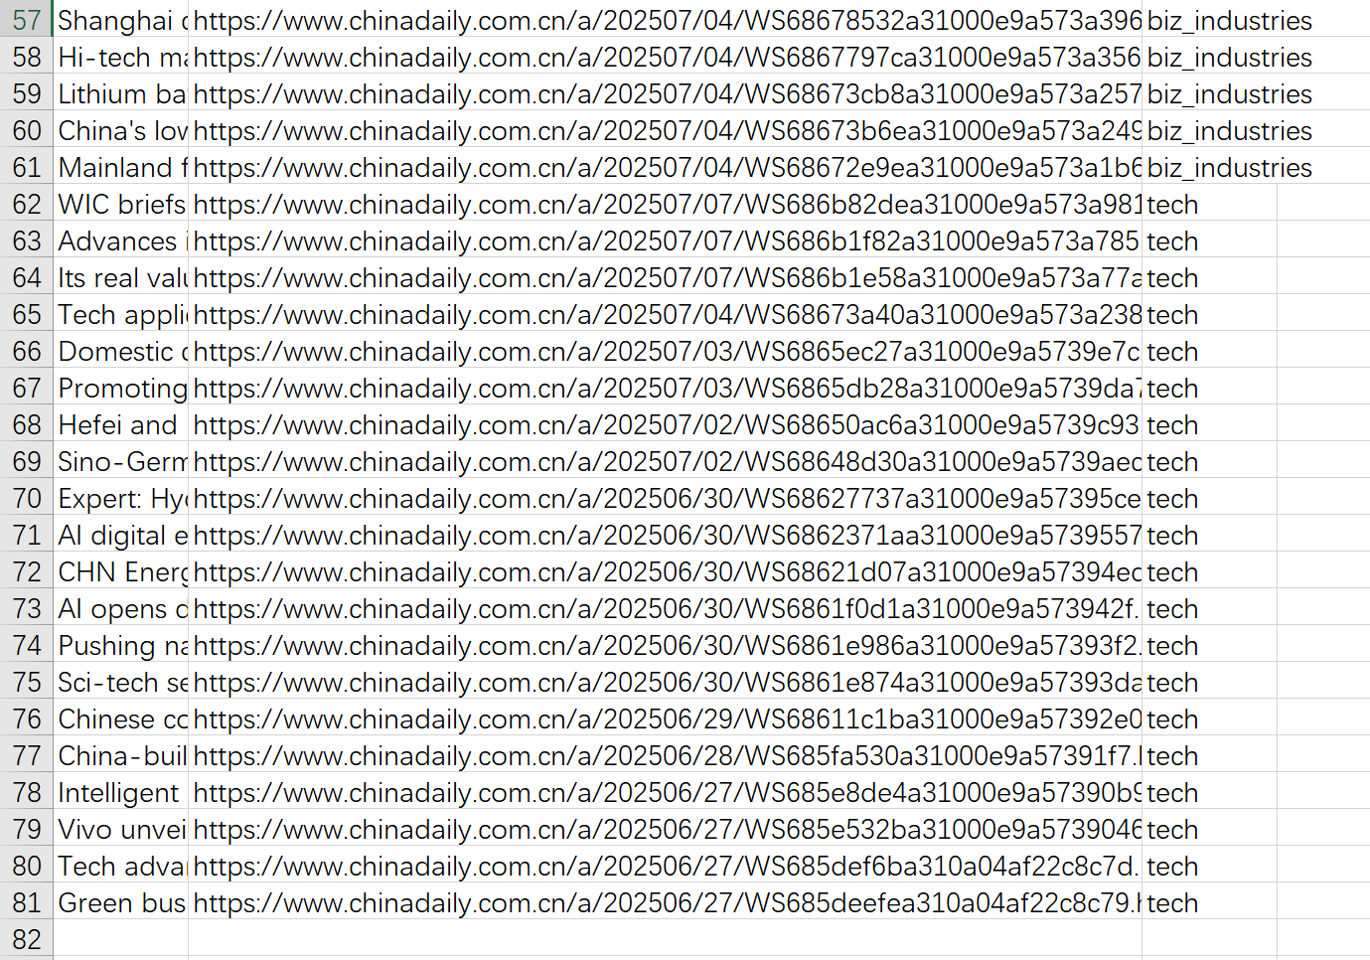
Scrape of China Daily:80 result

Slide 8
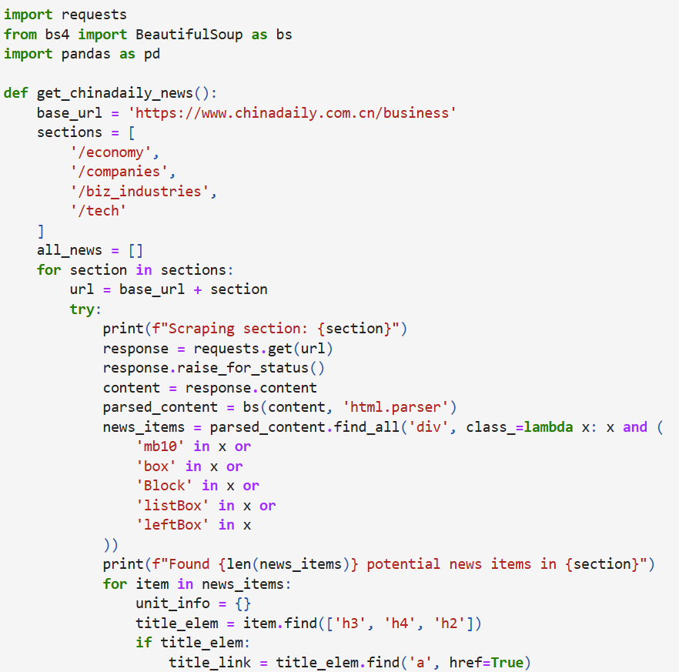
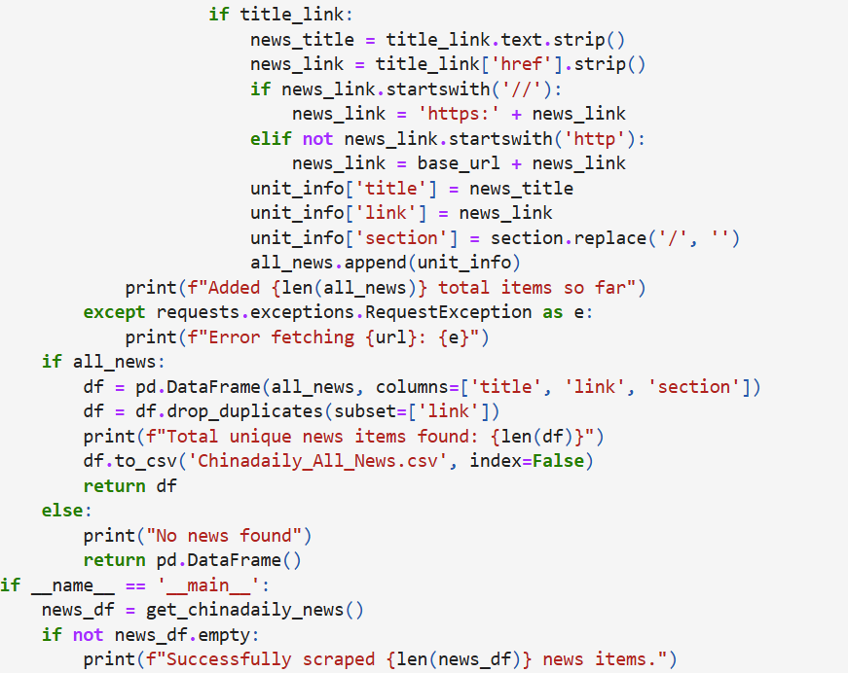
Scrape of China Daily:code

Slide 9
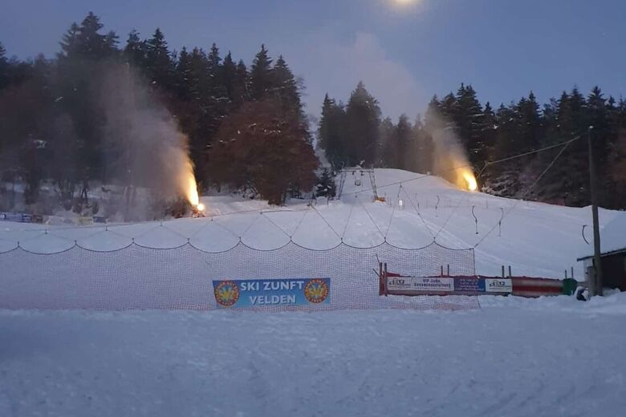
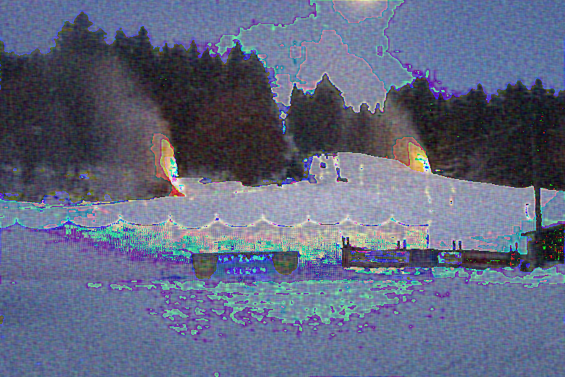
filtering

